Slide 1


Outcomes and Recurrence in Brain Tumor Patients
Analysis
Notes:
Hello I am Carlos Cantu
Welcome to today's presentation on brain tumor progression analysis. In the next few minutes, I'll be taking you through the key findings and implications of this study.
Lets dive into the intricate landscape of brain tumor progression.

Slide 2
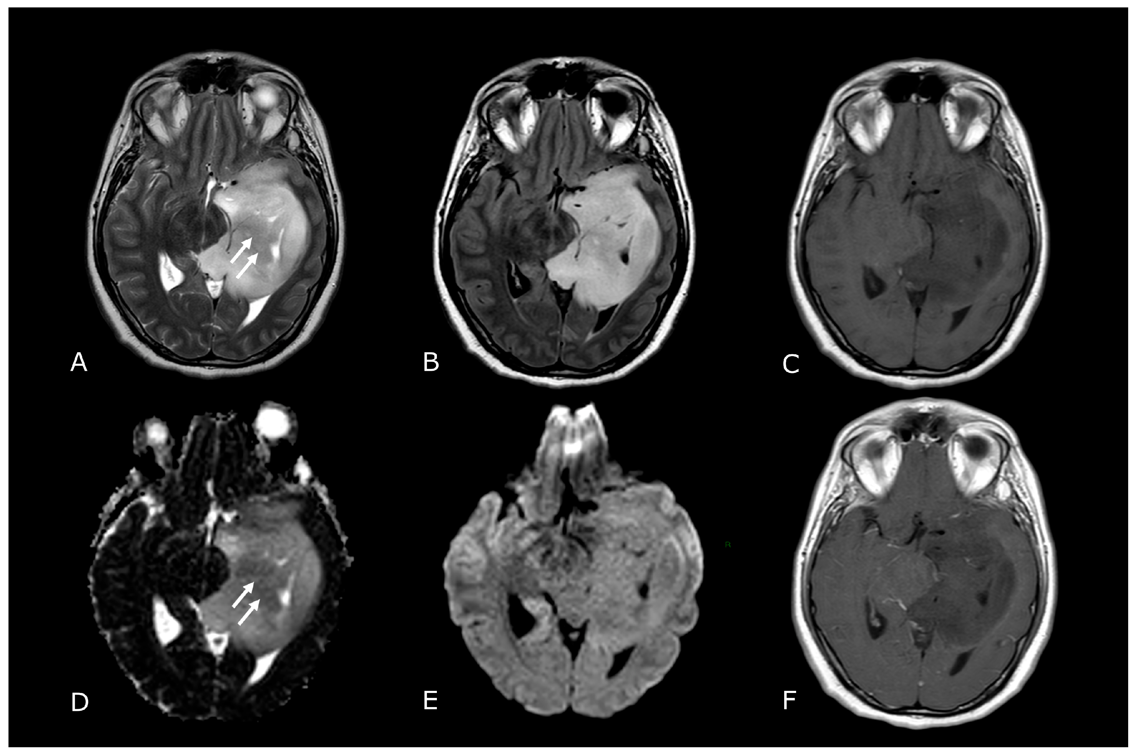
The Data
Stage-Based Analysis Investigation
Synthetic Data
Patient Characteristics
Treatment Outcomes
Notes:
The data consist of synthetic data that addresses the challenges posed by limited datasets, ensuring a well rounded analysis while safeguarding patient privacy.
By focusing on patient characteristics and treatment outcomes, we illuminate the path forward in neuro-oncology, striving for improved care and outcomes for every individual.

Slide 3
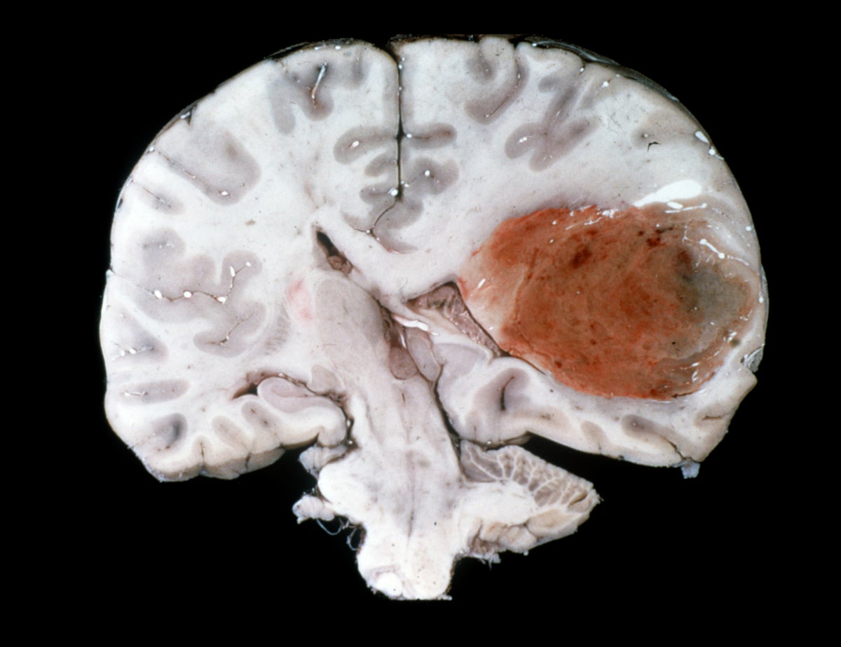
Initial Discovery
Standardized Column Names
2000 Rows and 11 Columns
Average Age 56.15 Years
Tumor Grade from 1 to 4
Missingness at 28.1%
Notes:
In the initial discovery we saw the dataset was relatively clean only requiring a few pre processing steps such as standardizing column names and adjusting column formats.
By standardizing column names and refining the data, we now are setwith a strong foundation for analysis. With 2000 rows and 11 columns, encompassing both numerical and string data, this dataset offers a abundant source of information.
The average age of our patients stands at 56 years old, reflecting the wide demographic landscape we navigate.
Tumor grades range from 1 to 4 underscore the complexity of the cases we study.
However, a challenge arises as we confront missingness at 28%, particularly concerning the recurrence data. Despite this hurdle, our dataset remains strong, ready for further exploration

Slide 4
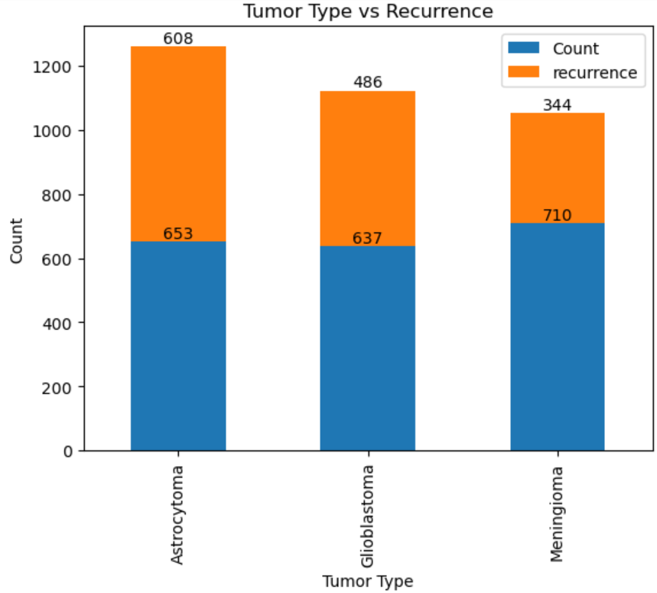
Tumor Type and Recurrence
Astrocytoma, Glioblastoma, and Meningioma
Notes:
As I explored the diverse tumor types within our dataset, including Astrocytoma, Glioblastoma, and Meningioma, I uncovered a fascinating landscape of variations in pathology and prognosis. Astrocytoma and Glioblastoma, both originating from astrocytes, present formidable challenges in treatment and management due to their aggressive nature. In contrast, Meningioma, arising from the meninges surrounding the brain and spinal cord, offers a distinct set of characteristics and considerations.
Despite its prevalence in our dataset, Meningioma exhibited the fewest tumor recurrences, while both Astrocytoma and Glioblastoma demonstrated similar frequencies. However, it was intriguing to note that despite their comparable occurrence rates, Astrocytoma displayed the highest number of tumor recurrences.
These findings emphasise the complex interplay between tumor type, occurrence frequency, and recurrence patterns, highlighting the nuanced nature of brain tumor pathology.

Slide 5
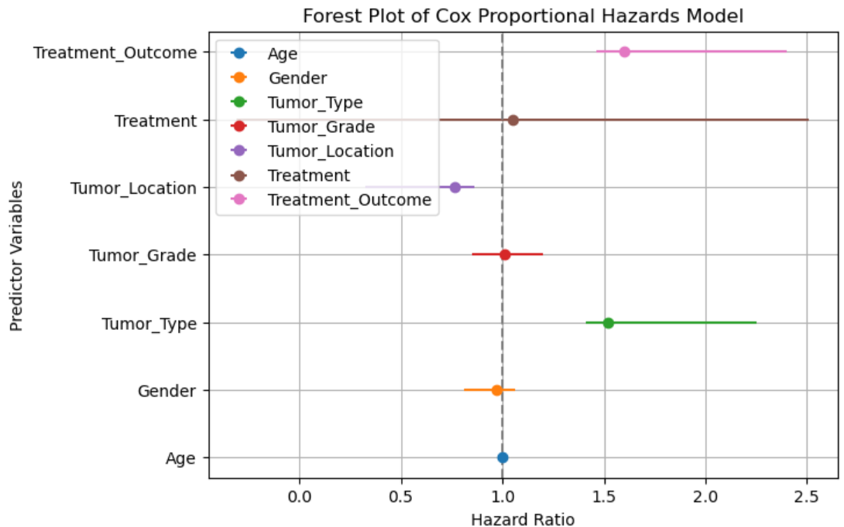
Cox Proportional Hazzard Regression
Age and gender show no significant impact on survival time
Glioblastoma patients face higher risk of shorter survival
Tumor location, especially in the temporal lobe, predicts better outcomes
Surgery with Radiation therapy stands out with a lower hazard ratio indicating better survival outcomes
Notes:
We dive into realm of survival analysis, particularly its application in understanding brain tumor progression through the Cox Proportional Hazards Regression method. This method has unveiled crucial insights into the factors influencing survival time among brain tumor patients. While age and gender seemingly play no significant role, findings reveal intriguing patterns regarding tumor type, location, and treatment modalities.
Glioblastoma patients face a higher risk of shorter survival, emphasizing the urgency in tailoring interventions for this aggressive form of brain cancer. Surprisingly, tumor location, particularly in the temporal lobe, predicts better outcomes, shedding light on the relationship between tumor biology and patient prognosis.
Furthermore, the analysis uncovers the differential impact of various treatments on survival. While surgery alone or combined approaches like surgery with chemotherapy pose higher risks, the integration of radiation therapy stands out as a beacon of hope, offering better survival outcomes.
Additionally, treatment responses significantly influence survival, with partial response, progressive disease, or stable disease showing lower hazard ratios compared to no response. These findings highlight the complexity of brain tumor management, with tumor type, location, treatment type, and outcome being crucial predictors of survival time.
Its important to note recurrence time and site were left out from the Cox Proportional Hazards Regression the reason for excluding recurrence time and site from Regression analysis is due to multicollinearity. Multicollinearity occurs when independent variables in a regression model are highly correlated with each other, which can lead to unstable parameter estimates and difficulties in interpretation.

Slide 6

Insights
Tumor Type is pivotal
Meningioma is most prevalent but has least recurrences
Temporal lobe improved survival outcomes
Surgery and radiation is most promising
Notes:
As we wrap up our exploration of brain tumor progression dynamics, let's highlight some pivotal insights:
Firstly, tumor type emerges as a critical factor, significantly impacting occurrence frequency and recurrence patterns. Despite Meningioma's prevalence, it surprisingly exhibits the fewest recurrences compared to Astrocytoma and Glioblastoma.
Moreover, our analysis reveals that tumors located in the temporal lobe are associated with improved survival outcomes, showcasing the importance of tumor location in prognosis.
In terms of treatment modalities, these findings highlight the effectiveness of combining surgery with radiation therapy, showing the most promising results in prolonging survival.
These insights point out the necessity for personalized treatment strategies tailored to individual patients' tumor characteristics and treatment responses. By deciphering the nuances of brain tumor progression, we equip clinicians with actionable insights to optimize patient care

Slide 7
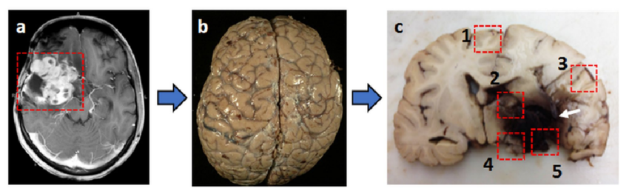
Assumptions and Ethics
Notes:
I'd like to highlight two critical aspects of the analysis
Firstly, in navigating the challenges of data scarcity and ethical considerations, synthetic dataset was used. This approach allowed for mimicing real-world scenarios while protecting patient privacy and confidentiality. By leveraging synthetic data, an expanded scope of the analysis is enhanced the strenthens the findings.
Secondly, a critical assumption was made: that all patients in the dataset would eventually succumb to the disease. This assumption served as a foundational framework for using survival time as a relevant metric to understand the dynamics of brain tumor progression.
By assuming that all patients would ultimately face the inevitable outcome of the disease, we could effectively capture the duration from diagnosis to this endpoint.

Slide 8
Questions
Can you explain how you ensured the accuracy and reliability of the synthetic dataset used in your analysis?
What specific statistical methods did you employ to identify predictors of survival time and recurrence patterns?
How did you address missing values in the dataset, and what impact did these missing values have on your analysis?
Can you elaborate on the assumptions made in your analysis and how they may have influenced the findings?
What were the main limitations and challenges encountered during your research, and how did you mitigate them?
Notes:
1: Can you explain how you ensured the accuracy and reliability of the synthetic dataset used in your analysis?
A: The accuracy and reliability of the synthetic dataset were ensured through design validation against real-world data as well I did confer with a medical student from Burrell College of Osteopathic Medicine
_{on its usefulness} 2: What specific statistical methods did you employ to identify predictors of survival time and recurrence patterns?
_{A:} I used Cox Proportional Hazards Regression analysis to identify predictors of survival time and patterns, considering variables such as age, gender, tumor type, location, treatment modalities, and outcomes.
3: How did you address missing values in the dataset, and what impact did these missing values have on your analysis?
A: As the missing values were specific to recurrence time and site they had no effect on the analysis in the conducted manner.
_{4:}
Can you elaborate on the assumptions made in your analysis and how they may have influenced the findings?
_{A:} Assumptions included the inevitability of disease progression and the use of survival time as a relevant metric, this allowed for a simplifying analysis but potentially overlooking treatment variations
5: What were the main limitations and challenges encountered during your research, and how did you mitigate them?
A: such Limitations included the dataset representativeness and missing values, mitigated through preprocessing.

Slide 9
Questions
Could you provide more details on the predictive models developed for recurrence time and their performance metrics?
How did you ensure that patient-centered approaches were incorporated into the analysis and interpretation of the results?
What ethical considerations guided your research, particularly concerning the use of synthetic data and patient privacy?
Can you discuss any potential biases in the dataset or analysis methods used, and how you addressed them?
What are the practical implications of your findings for clinicians, policymakers, and patients in the field of brain tumor management?
Notes:
6:although a model was not discussed we did explore a Predictive model for recurrence time utilizing a random forest, evaluated through performance at 96%.
7: As this was a analysis of synthetic data Patient-centered approaches were not incorporated but the evolution of this study would go about this by involving patients in treatment decision-making and aligning the treatment plans with their preferences and values.
8: Ethical considerations focused on transparency, data protection, and adherence to established guidelines for synthetic data usage.
9: In the context of synthetic data, inherent biases are minimized, and since we didn't observe any biases during our analysis, we can assume that biases were effectively mitigated.
10: Practical implications include optimizing treatment strategies, informing healthcare policies, and empowering patients with personalized care options in brain tumor management.

Slide 10

Thank You

